Slide 1

IN
INTERNATIONAL UNION
OF OPERATING ENGINEERS
LOCAL 487
HEALTH & WELFARE TRUST FUND
Board of directors
MEETING
NOVEMBER 11, 2021

Slide 2
Topics For Discussion
Overview
Financial Overview
Other Matters

Slide 3
Overview

Slide 4




AUDIT TEAM
Dina Bellows-Levine, CPA Partner
Jennifer R. Koffman, CPA Partner
Kyle Nelson , CPA Manager
Michael Modreck, CPA Senior
Patricia Reyes Staff

Slide 5
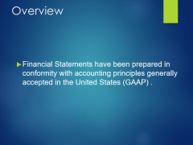
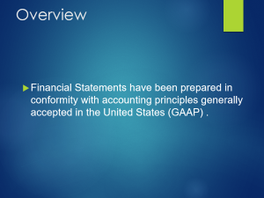
Overview
  Financial Statements have been prepared in conformity with accounting principles generally accepted in the United States (GAAP) .

Slide 6
Financial Overview

Slide 7
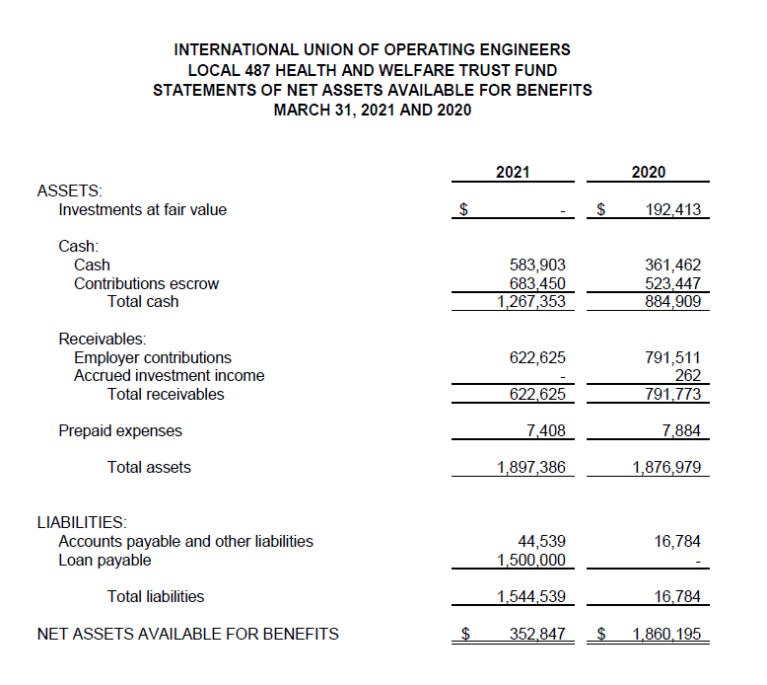

Slide 8
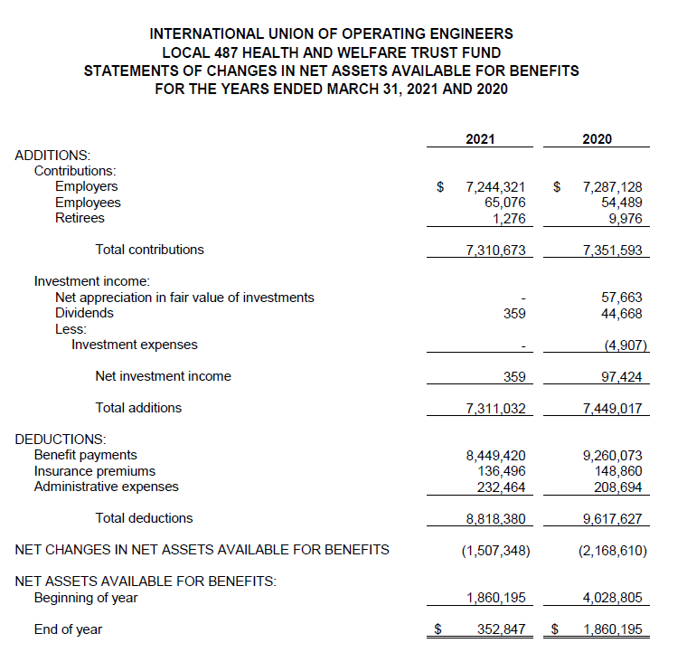

Slide 9
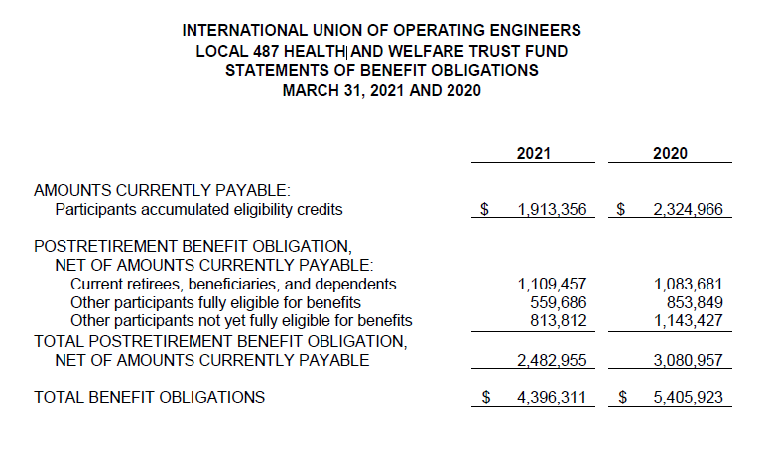
Statement of Functional Expenses

Slide 10
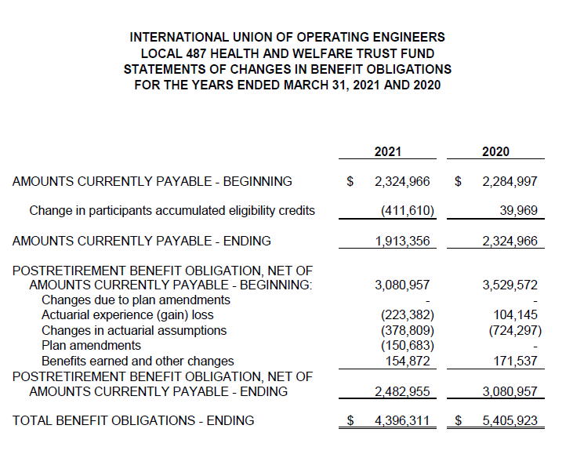

Slide 11
Other Matters

Slide 12
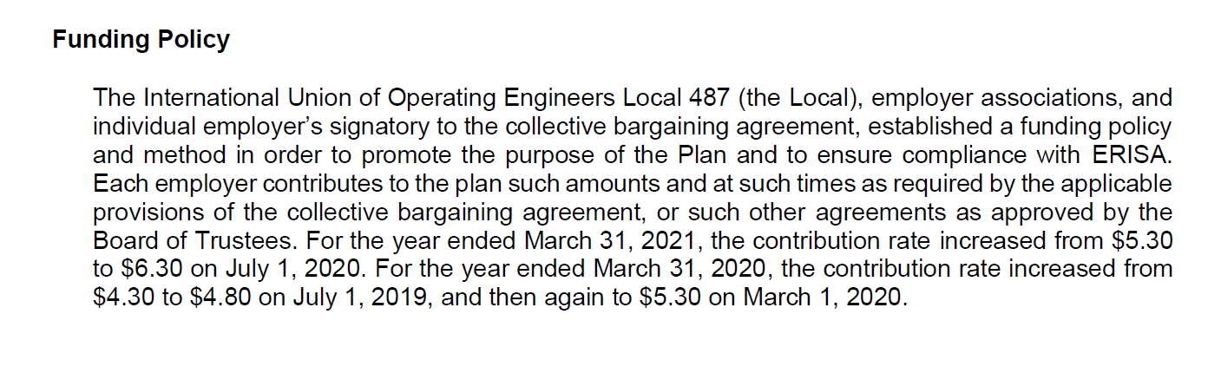

Slide 13
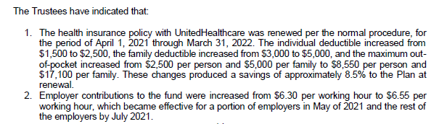


Slide 14
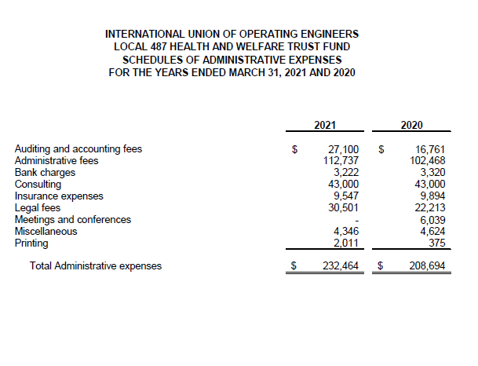

Slide 15

MATTERS TO DISCUSS
AFTER THE AUDIT

Slide 16

observations
Post audit communications
Form 990 and 5500

Slide 17
OBSERVATIONS
MANAGEMENT TEAM COOPERATIVE WITH REQUESTED INFORMATION
NAVIGATING THROUGH COVID-19

Slide 18
POST COMMUNICATION
Qualitative Aspects of Accounting Practices
Difficulties Encountered in Performing the Audit
Corrected and Uncorrected Misstatements
Disagreements with Management
Management Representations
Management Consultations with Other Independent Accountants
Other Audit Findings or Issues

Slide 19






